Slide 1



Jump-Start Research

Slide 2




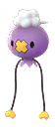

A Spooky Message

Slide 3
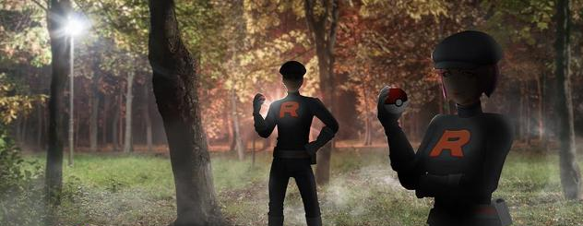
A Troubling Situation

Slide 4




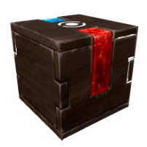
Let’s GO Meltan Quest

